Slide 1
Bayesian Networks Structure Learning: A Survey
Survey 1st Version
Jiaqi Yang
jyang2@gradcenter.cuny.edu

Slide 2
Outline
Survey 1st Version
Abstract
Introduction:
Global optimal search
Local search
Neural network related combinatorial problems
Background:
Learning Networks and NP-hard explanation
Introduction to Local Score Functions, and related papers
Local Optimal Learning:
Order-based Local Search
Neural Network Related Combinatorial Problems
Globally Optimal Learning (including k-degree constraint)
Integer Linear Programming
Dynamic Programming
Shortest-path Concept Search
Algorithms’ Improvement
Constraint Programming
Heuristic Functions
Comparison of different algorithms
References

Slide 3
Introduction
Survey 1st Version
What is Bayesian Network?
Why is Bayesian Network useful in real-world?
What are the state-of-art algorithms to solve the learning problem given one dataset?
What is the different between my survey and others’.
The outline and categories I will discuss later.

Slide 4
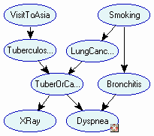
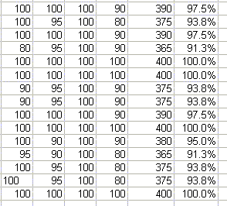


Introduction
Survey 1st Version
structure
numerical parameters
data

Slide 5
Survey 1st Version
Background
Discuss why learning Bayesian networks is NP-hard problem.
Some papers contributed to define the problem:
A Bayesian method for the induction of probabilistic networks from data. Machine Learning —— F. Cooper and E. Herskovits
Large-sample Learning Bayesian networks is NP- hard
—— Chickering, D. M.

Slide 6


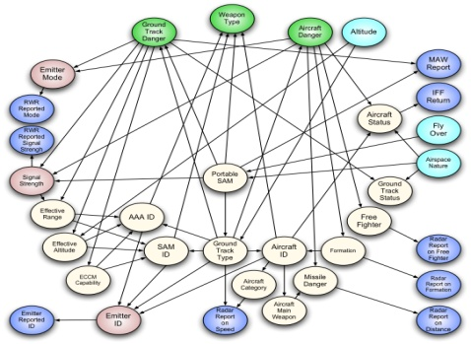
Background
Survey 1st Version
The way score-based functions work:
Find a Bayesian network that optimizes a given scoring function
Two major issues
How to define a scoring function?
How to formulate and solve the optimization problem?

Slide 7


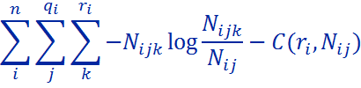

Background
Survey 1st Version
BDeu
MDL
fNML

Slide 8
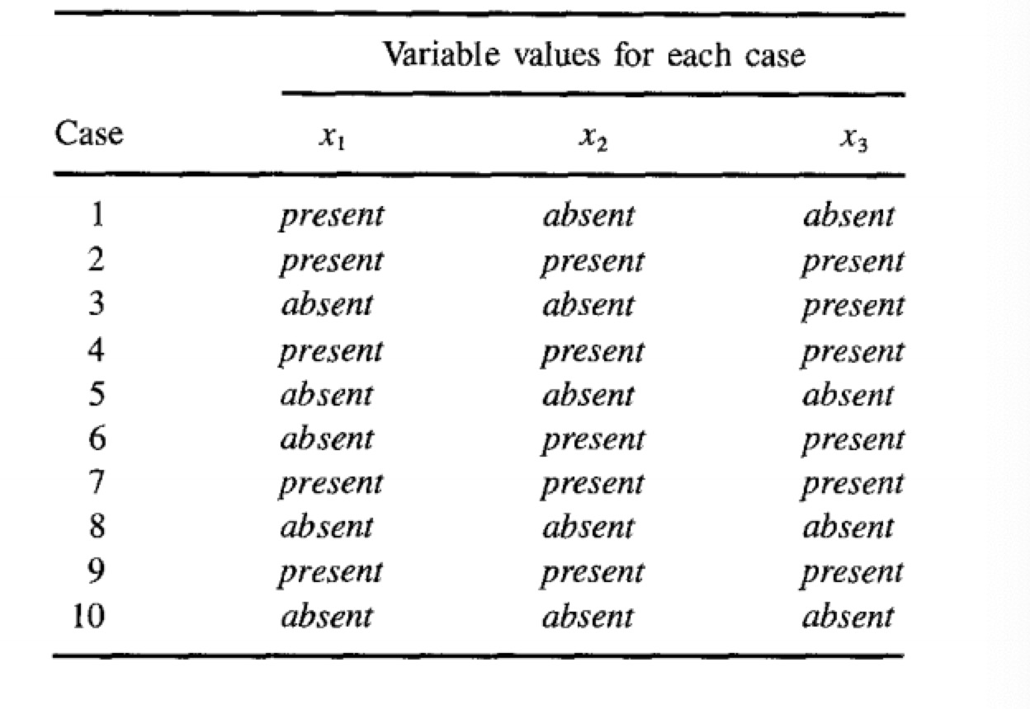
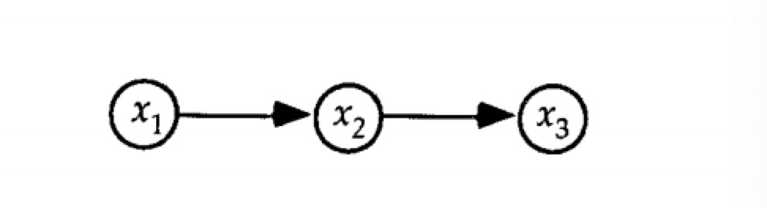
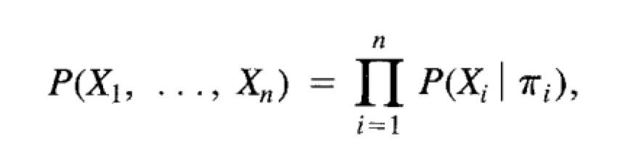
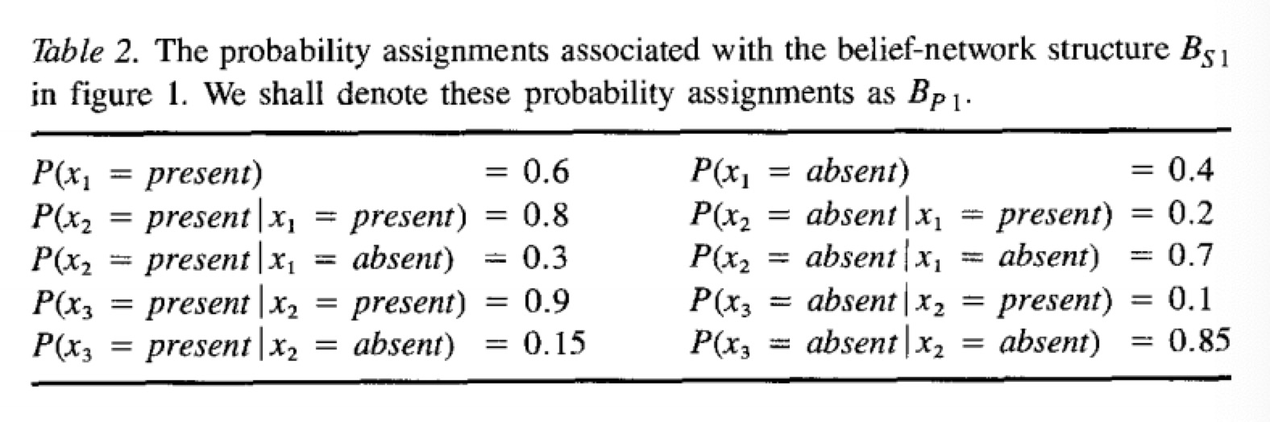
Papers [Bayesian Belief Network]
Survey 1st Version
A Bayesian method for the induction of probabilistic networks from data.
Gregory F. Cooper, Edward Herskovits. -- 1992
One of the earliest algorithms for learning Bayesian Network structure
Presents a Bayesian method for construction probabilistic networks from databases

Slide 9
Papers [NP-hard Proof]
Survey 1st Version
Learning Bayesian networks is NP-complete.
Chickering D.M. -- 1996
Large-Sample Learning of Bayesian Networks is NP-Hard.
Chickering D. M., Meek C., Heckerman D. -- 2003
In the large-sample version of the learning problem, the learning Bayesian network problem reduced a known NP-complete problem.
They showed that learning is NP-hard using a reduction from a restricted version of the NP-complete problem FEEDBACK ARC SET.
The general FEEDBACK ARC SET problem is stated by Garey and Johnson (1979)
It’s NP-hard even the in degree is set to small number (k > 1)

Slide 10
Papers [Score Measures]
Survey 1st Version
Probabilistic Network Construction Using the Minimum Description Length Principle.
Remco R. Bouckaert -- 2003
Even we get a topologic order for all variables, the network structures are exponential.
Based on the MDL measure, they presented a new heuristic algorithm for learning network structures at the same time. (K3)
Good quality measure of the network.
Slightly faster with fewer arcs (parents)
Algorithm performance they proposed highly dependents on a given ordering

Slide 11
Local Optimal Learning
Survey 1st Version
Order-based local search:
Search the ordering instead of search the whole space
Time and space saving
The one with highest score is selected between many local optimal network structures.
Approximate network is chosen instead of BEST, working good on large dataset
Paper proposed a measure skill gives local searching, while with not perfect ordering heuristics

Slide 12
Papers [Local Search]
Survey 1st Version
Learning Bayesian Networks: Search Methods and Experimental Results.
Checkering D. M. , Geiger D. , and Heckerman D. – 1995
Improved a network iteratively: adding an edge, removing an edge, or flipping an edge
To alleviate local maxima, hill climbing is augmented with random restarts
Space searching to modify the structures locally
Learning Bayesian Network Structure from Massive Datasets: The “Sparse Candidate” Algorithm.
Nir Friedman, Iftach Nachman, Dana Peer – 1999
This iterative algorithm restricts the parents of each variables to a small subset of candidates (Parents)
Selecting better candidates for each iteration using hill-climbing algorithm
Faster but quality of the learned network decreases

Slide 13
Papers [Order Local Search]
Survey 1st Version
Ordering-based search: A simple and effective algorithm for learning Bayesian networks.
Marc Teyssier and Daphne Koller – 2005
Proposed that search over the space of node orderings
Improved the searching speed largely
Pruned lots of possible parents in advance
Metaheuristics for Score-and-Search Bayesian Network Structure Learning
Colin Lee, and Peter van Beek – 2017
Extending previous work on ordering-based search (OBS)
Scale upwards to thousand variables, with an efficient traversal method for a larger neighborhood and the usage of more complex metaheuristics

Slide 14
Global Optimal Learning
Survey 1st Version
Exact algorithms can learn optimal Bayesian networks.
Scalability problem
Local optimal cannot guarantee the solution
Scalability problem (< 60)
Integer Linear Programming
Dynamic Programming
Shortest-path Concept Search

Slide 15
Papers [Dynamic Programming]
Survey 1st Version
Solve subproblems
Not always efficient due to their need to fully evaluate an exponential solution space.
Space problem then more constraints introduced to DP methods.
Exact Bayesian Structure Discovery in Bayesian Networks
Mikko Koivisto, and Kismat Sood -- 2004
Finding Optimal Bayesian Networks by Dynamic Programming
Singh,A. and Moore,A -- 2005
Memory-Efficient Dynamic Programming for Learning Optimal Bayesian Network
Brandon Malone and Changhe Yuan -- 2011

Slide 16
Papers [Shortest-path Search]
Survey 1st Version
Breadth-first search
Depth-first search
A* search
Either running time problem or scalability problem in any of them
More constraints are added, and pre-detecting pruning methods applied at the same time.
Learning Optimal Bayesian Networks Using A* Search.
Changhe Yuan, Brandon Malone, and Xiaojian Wu – 2011
Discussed in Topic exploration
Machine learning of Bayesian networks using constraint programming.
Peter van Beek and Hella-Franziska Hoffmann – 2015
Discussed in Topic exploration
Order-based Depth-first BnB search

Slide 17
Thanks!

